Slide 1
Allegories, Parables, & Fables
Please copy into the Class Notes section of your notebook.

Slide 2
Allegory = the literary form of Lord of the Flies
The literary form of the animal fable has been used for centuries.
  Animal fables are short stories that teach a moral lesson. They include animals that often talk and act like humans. (Ex: Aesop’s fables)

Slide 3
Concept Development:
Fable
Represents arrogance
Animals
Used to teach moral lessons to children
Animals/characters represent
  Virtues = good human qualities
  Vices = bad human qualities
  **Fables teach lessons about life**
Represents Perseverance

Slide 4
Example of an Aesop Fable…
Another example of a famous fable is the following from Aesop’s Fables:
The Hound Dog and the Rabbit
One day, a hound dog was hunting for a rabbit and managed to find one. The hound chased the rabbit for a long time, but eventually, the rabbit escaped. When another dog made fun of the hound dog for allowing the rabbit to escape, the hound dog replied: “You do now see the difference between the rabbit and I; I am only running for my dinner, while he is running for his life.”
The lesson: Incentive will spur effort

Slide 5
Read at least two (2) Aesop fables…
Which animals are being used? Any reason(s) for choosing these particular animals, i.e. personality traits, characteristics, etc.?
What is the moral that is expressed? Write it down.

Slide 6
What personality traits could be associated with the following animals?
  A pig
  A horse
  A sheep
  A donkey
  A cow
  A rat
  A dog
  A new animal of your choosing…

Slide 7
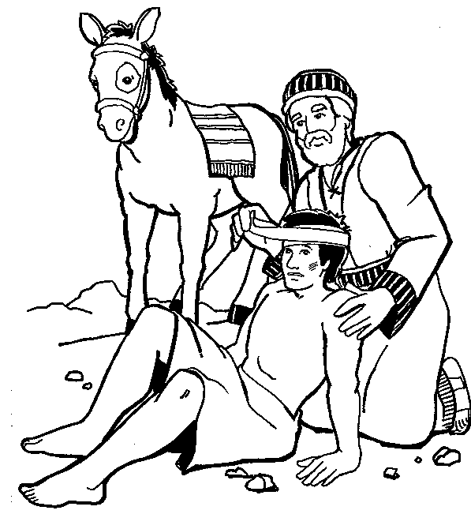
What is a Parable?
Type of ALLEGORY set in the real world.
Teaches a lesson about ethics or morality.
Story used to illustrate a moral or spiritual lesson, as told by Jesus in the Gospels.
Remember the Good Samaritan??
-Many stories in the Bible are parables

Slide 8
Animal fables and parables soon developed into more complex forms of literature called allegories.
  An allegory is a story that includes characters, setting, etc. that have both literal and figurative meanings.
  In some types of Allegories, the characters and setting represent abstract ideas of moral qualities.
  In other types, characters and situations stand for historical figures and events.

Slide 9
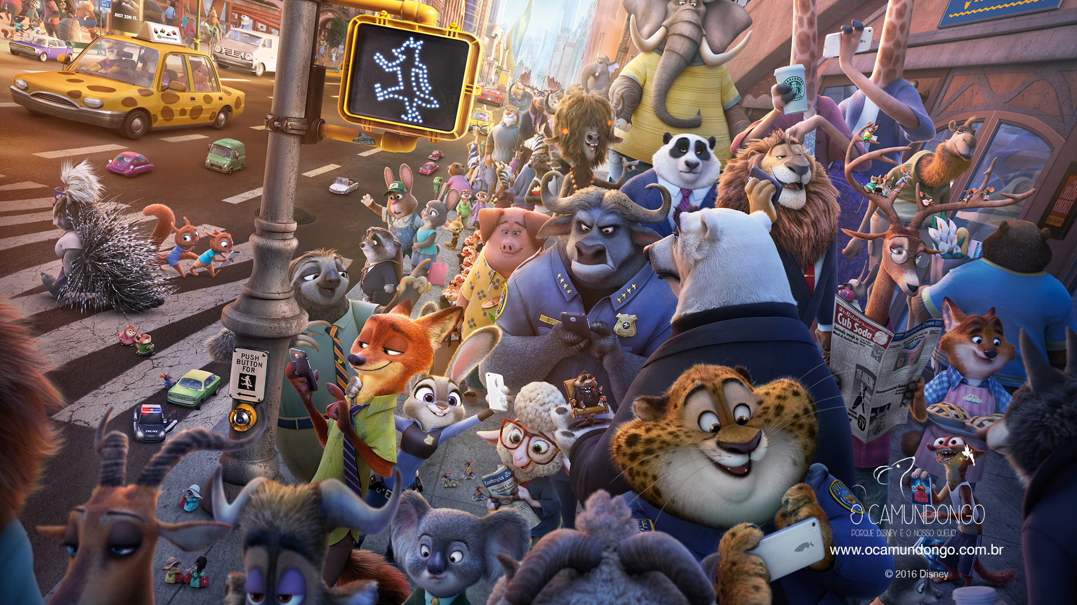
Zootopia as an allegory…

Slide 10
Examples of Allegories
An Allegory can be read on one level for its literal or straightforward meaning
An allegory can be read for its symbolic, or allegorical meaning
Allegories are often intended to teach a moral lesson or make a comment about goodness and depravity.

Slide 11
Examples of popular Allegories and Parables…
Some famous parables and allegorical stories/movies/television programs are:
Animal Farm
“The Emperor’s New Clothes”
The Wizard of Oz
“The Boy Who Cried Wolf”
Avatar
The Matrix
Of Mice and Men

Slide 12

Allegory continued…
In a old English play called Everyman, the main character is named Everyman (he stands for exactly what his name indicates.)
One day Everyman is summoned by death to give an accounting of his life.
Everyman asks his friends Fellowship, Beauty, Strength and Good Deeds to go with him to tell Death that he has led a good life.
Only Good Deeds stays with him until the end.
What do you think the lesson is from this story?

