Slide 1
Deus ex Machina
Please copy into the Class Notes section of your notebook.

Slide 2
What is Deus ex Machina?
Literal meaning – “god by machine”
Dramatic meaning – In early Greek theater above the performers a machine would lower a “god” who would pull the actor up and “rescue” him.
Modern literary usage – The phrase has come to mean any incident in drama or literature in which a character/characters are rescued at the last minute by an outside force.
Term used to describe how difficult or impossible situations are solved suddenly.
Often solved with some unexpected character, power, or object that is introduced.

Slide 3
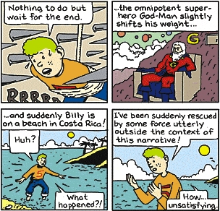
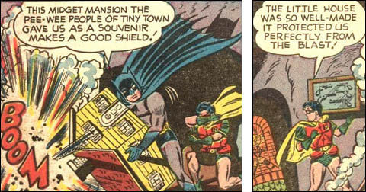
Deus ex Machina in cartoons…

Slide 4
Other examples of Deus ex Machina that we’ve seen in literature, film, television?
Deus ex Machina or not???

Slide 5
Please respond to the following discussion questions…
1. Why do you think that William Golding chose to end the novel this way?
2. Do you think that this was a fitful end to the novel? Why or why not? Explain.
3. Where do you think the boys will be in five (5) years? Describe Ralph, Jack, Roger, and the rest of the group.

