Slide 1
Introduction to The Taming of the Shrew by William Shakespeare
Please copy into the Class Notes section of your notebook.

Slide 2
3 Characteristics of a Shakespearean Comedy
1. Happy Ending | 2. Love | 3. Mistaken Identities
The would-be lovers must overcome obstacles, before they have a harmonious union (often a wedding). | The theme of love is prevalent in every Shakespeare comedy. | In Shrew, Tranio becomes Lucentio and Lucentio becomes “Cambio”, Bianca’s teacher, in order to get close to her.

Slide 3
Keep in mind that TotS is a play within a play…
We open the play with Christopher Sly, a poor vagrant who falls asleep drunk in front of a tavern.
Some wealthy nobleman stumble upon Sly, and attempt an elaborate prank:
They will carry Sly into their home, and treat him like a lord when he wakes up.
The Taming of the Shrew is the play that they put on for him.
Christopher Sly is never mentioned or heard from again.

Slide 4
What is a shrew?
Small mouse-like mammal with a long snout; related to moles. Known for its ugly temper ☹
*Also, a woman with a bad temper

Slide 5
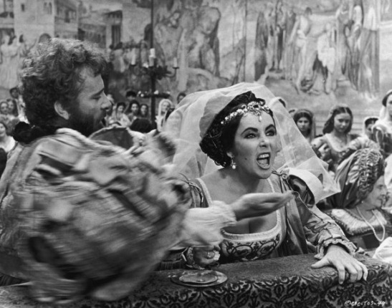
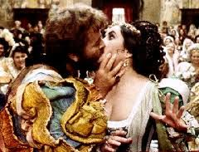
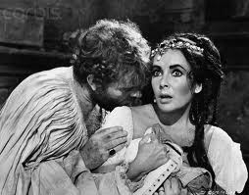
Katharina and Petruchio– a marriage made in heaven?

Slide 6
Who is the shrew in the play?
Katherina, “Kate” – the title character of the play.
The eldest and unmarried daughter of Baptista Minola, no man wants anything to do with her because she's got a hot temper, slaps people around when they make her mad, and shreds men to bits with her razor sharp tongue.

Slide 7
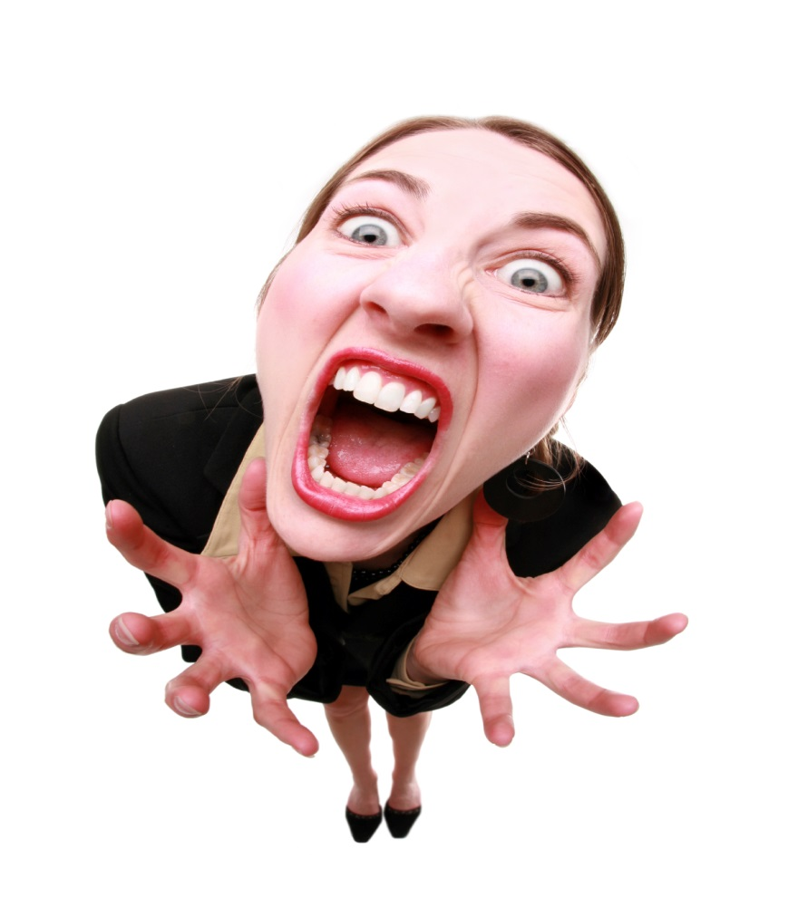
Reasons she might be shrewish:
furious at the world (unfair era for women)
motherless; perhaps lack of positive female guidance?
jealous of Baptista’s overt love and kindness to Bianca.
angry that no one likes her?
“no one ever taught me how to play nice… poor me…”

Slide 8
The Characters…
Lucentio
(pretends to be Cambio Bianca’s teacher)
Bianca
Kate’s younger and much sweeter sister
…Lucentio really likes Bianca, but…

Slide 9
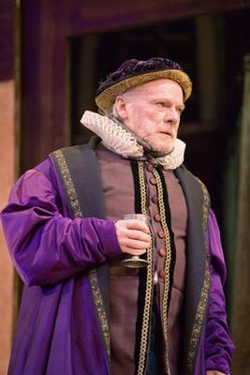
The Dad
Baptista
(the girls’ dad– kind of a hard-nosed guy)
Won’t marry off the younger sister Bianca, until he gets rid of Kate the Shrew.
Bummer for Bianca and Lucentio. ☹

Slide 10
What’s the #1 Conflict?
The dad refuses to “marry off” the younger daughter before the older one gets married.
Several Reasons:
1. he has to give a substantial dowry for each girl– this is expensive.
2. he has to live with Kate forever if Bianca gets married, and he likes Bianca better.

Slide 11
Here is where Petruchio comes in…

Slide 12
Petruchio
Petruchio is a wealthy bachelor who is on the prowl for a rich wife. When he hears about Katherine Minola, he agrees to marry her despite (or, perhaps because of) her reputation as a shrew.

Slide 13
What’s the main conflict?
Petruchio must “tame” wild Kate.
He begins taming her even before their wedding (she has no choice but to marry him). Girls had to do what their fathers told them to do, regardless of their own feelings.

Slide 14
