Slide 1
What is Satire?
Please copy into the Class Notes section of your notebooks.

Slide 2
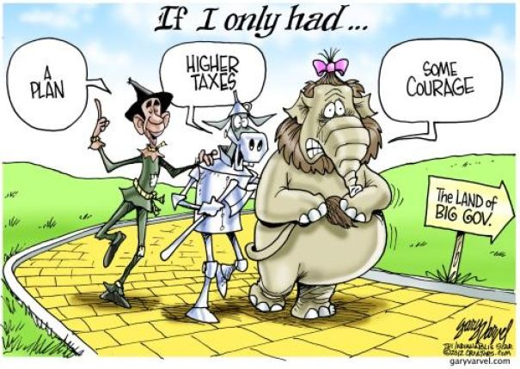
Satire (noun):
A work that ridicules its subject through the use of techniques such as exaggeration, reversal, incongruity, and/or parody in order to make a comment or criticism about it.

Slide 3
The Many Forms of Satire…

Slide 4
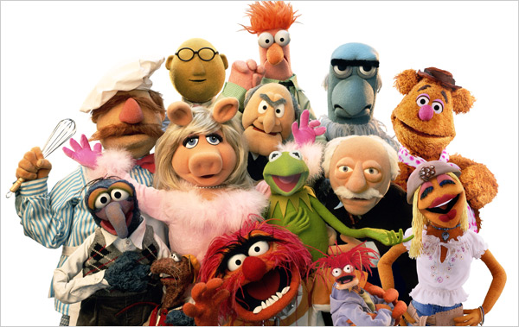
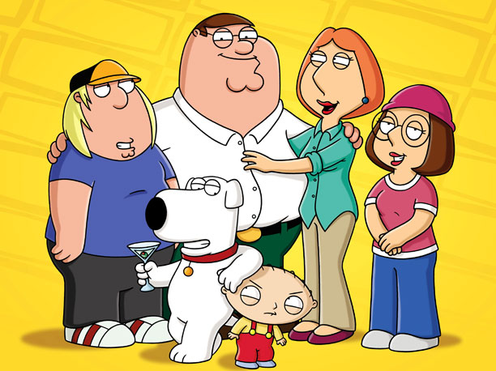

Slide 5
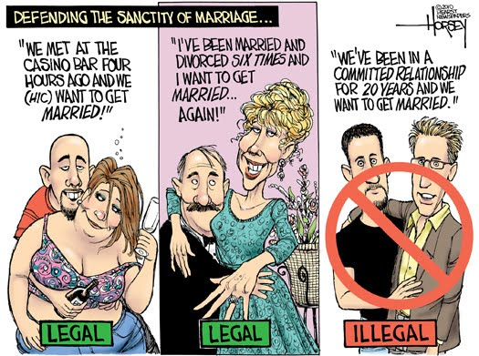
Distortion / Exaggeration
To enlarge, increase, or represent something beyond normal bounds so that it becomes ridiculous and its faults can be seen.
Focuses on a specific quality and extends that beyond reality. A weakness is exposed and made to seem bigger than it is.

Slide 6
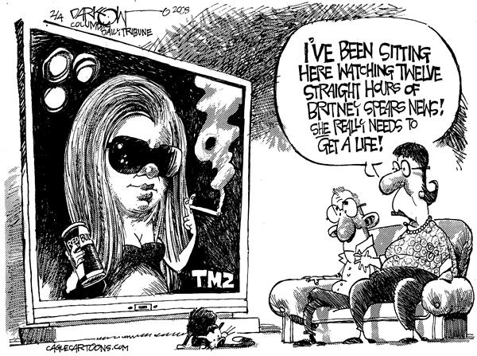
Distortion / Exaggeration, cont’d…
Hyperbole – character stereotypes, political and entertainment caricatures.
Understatement / Downplay – minimize the significance or importance of something to show how it is treated as something less important than it really is.

Slide 7
Incongruity
To present things that are out of place or are absurd in relation to its surroundings.

Slide 8
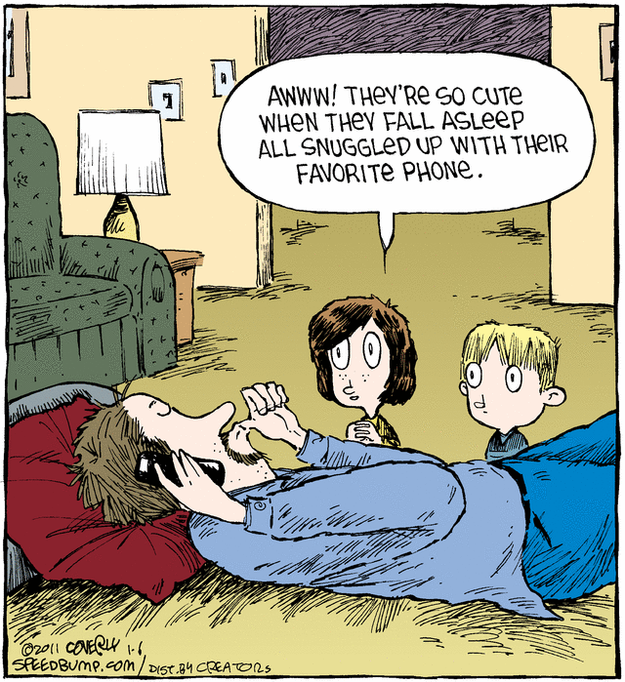
Reversal
To present the opposite of the normal order (e.g. the order of events, hierarchical order).

Slide 9
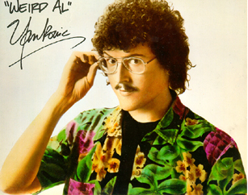
Parody
To imitate the techniques and/or style of some person, place, or thing.

Slide 10
Parody, continued…

Slide 11
Irony
Irony - a reversal of expectations.
Three Forms of Irony:
Situational - the opposite of what is expected to happen is what actually occurs.
Dramatic - audience/reader knows more than characters
Verbal - a discrepancy between what is said and what is meant.
Let’s take a look at the following images… Which form of irony is being used?

Slide 12
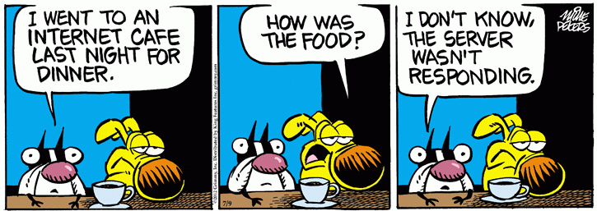

Slide 13
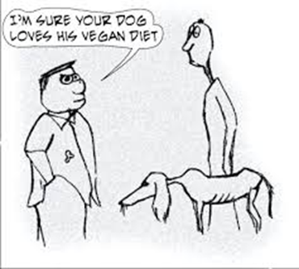

Slide 14
Questions to ask yourself in understanding and analyzing satire…
1. Who is the speaker?
2. What is being attacked?
3. Who is the intended audience and how do you know?
4. How is it being attacked? What tools are used?
5. How vicious is the attack? What is the tone? (bitter, tolerant, spiteful, playful)
6. How clear and successful is the attack? Would the intended audience be effectively impacted?

Slide 15
The Onion Article Response
Read The Onion article titled, “Intrepid Middle-Class Parents Embark on Daring Search for Mythical Perfect School District.”
Respond to the following questions in complete sentences in your notebook:
1. What does the author assume about the attitudes of the audience in the piece?
2. What aspect of society is the author satirizing?
3. What is the goal or purpose of the satire?
4. How effective are the author’s methods?
5. Which satirical methods is the author using in his approach? Exaggeration, incongruity, reversal, parody, irony? A combination of a couple? Explain.

