Slide 1
Critically Reviewing Art
Please copy into the Writing Assignments section of your notebook.

Slide 2
Please copy the following questions in your notebooks. These questions will be the lens you use to analyze each piece of art…
Be sure to thoroughly answer each of the following questions:
What is the artist trying to do/say?
Describe the statement that the artist is attempting to make.
How well is he/she doing at making this statement?
Specifically, what are the strengths of the piece?
What are the weaknesses of the piece? Explain.
Was it worth doing and why?
Does the piece convey something worthwhile, powerful, meaningful, etc.? Why or why not?

Slide 3
Gallery Walk
Conduct a gallery walk around the classroom and analyze each piece of street art.
It might help if you use your phone to take a picture of each piece. That way you can come back to it later…
Keep in mind that art is essentially in the eye of the beholder. You may interpret it differently than your neighbor. What do you think/see when you examine this particular piece? This is entirely your own opinion/response.

Slide 4
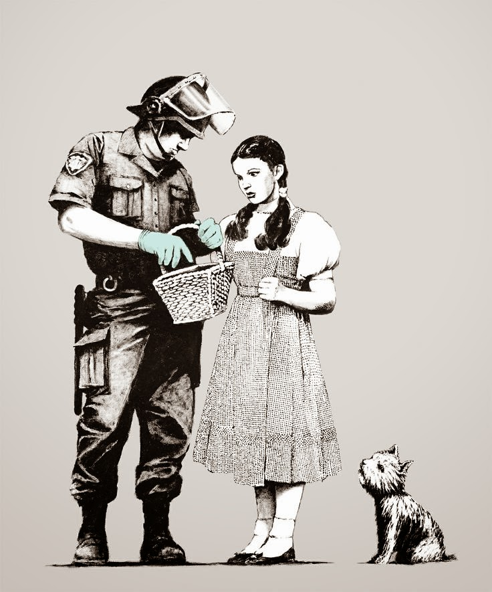

Slide 5
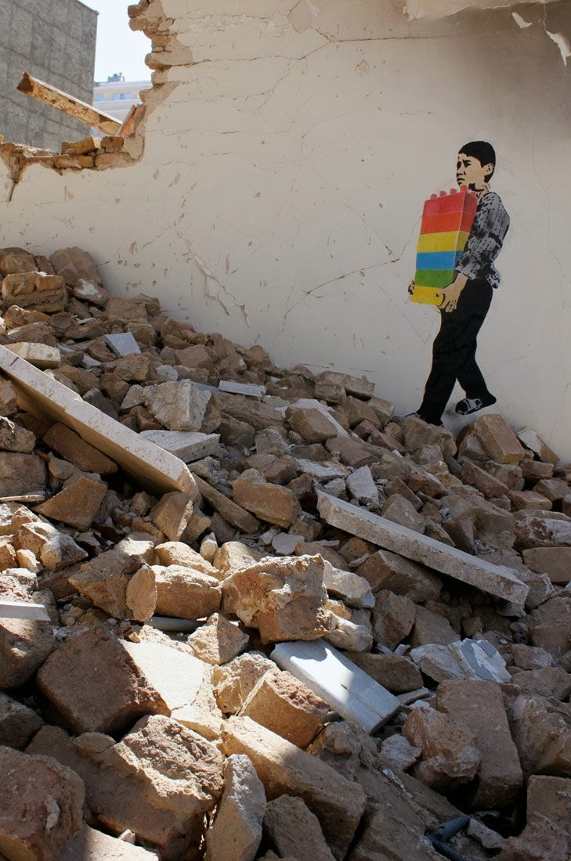

Slide 6
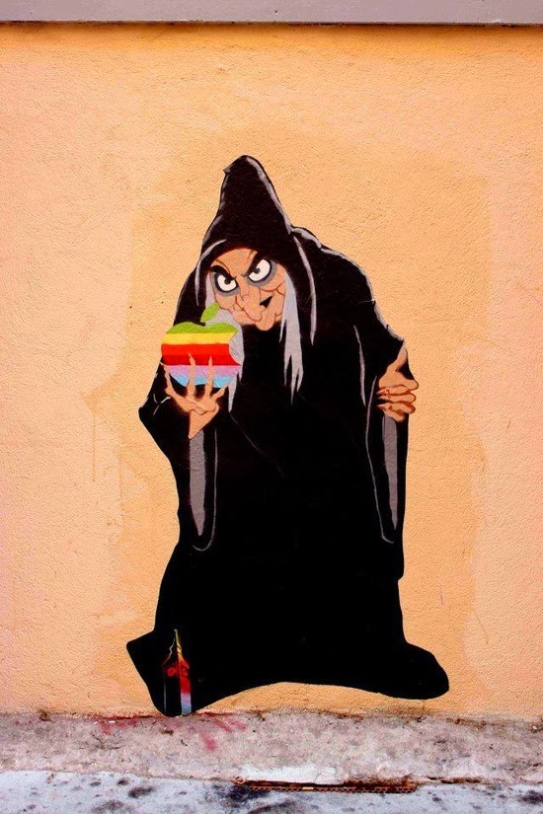

Slide 8
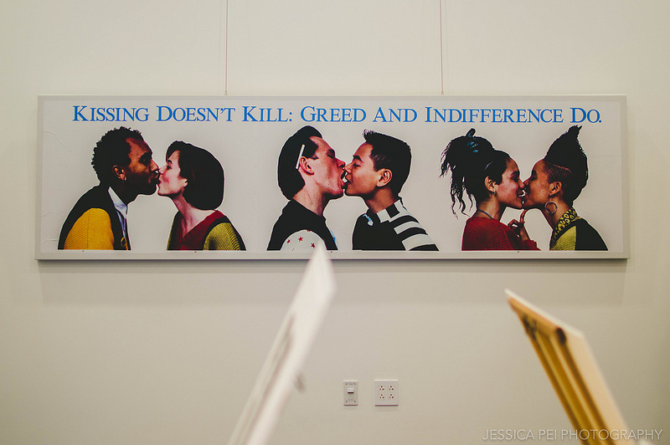

Slide 9
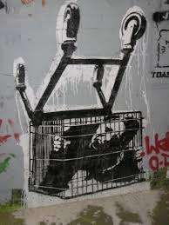

Slide 11
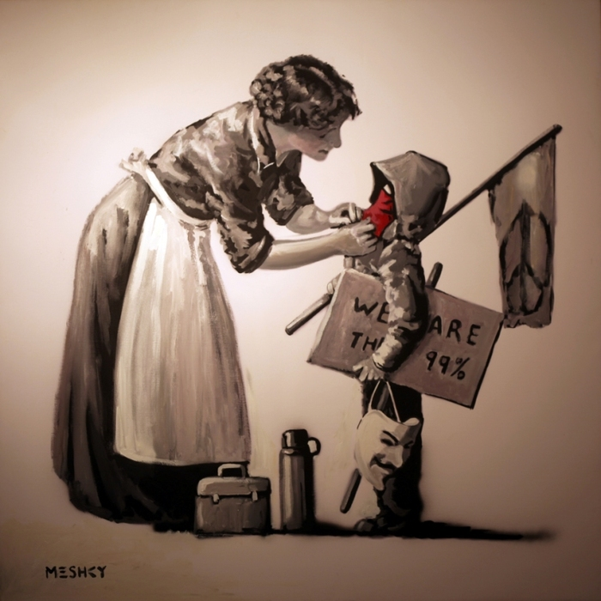

Slide 12
On your own…
Find two (2) other pieces of street art (this is an opportunity to use your phone) and answer the three (3) guiding questions for each piece. Try to find pieces that attempt to make a statement!
What is the artist trying to do/say?
Describe the statement that the artist is attempting to make.
How well is he/she doing it?
Specifically, what are the strengths of the piece?
What are the weaknesses of the piece? Explain.
Was it worth doing and why?
Does the piece convey something worthwhile, powerful, meaningful, etc.? Why?

