Slide 1
January 12, 2017
Elements of Satire in Example Videos
We will watch the next three (3) clips. As we view them, analyze which elements of satire are being used in each one. Be sure to describe the element(s) and explain how it is being used. Please refer to your notes from Tuesday.
Elements of Satire:
Exaggeration
Incongruity
Reversal
Parody
Irony

Slide 2
April 5, 2017
Masculinity Today
Masculinity can be defined as “the possession of the qualities traditionally associated with men.”
In your opinion, how is masculinity seen in society today? In other words, what are the traditional qualities associated with men? List and describe at least 3-4.
Do you think that the current perception(s) of men in society today is positive or negative? Why? Explain.
Describe some of the positive characteristics of masculinity today. How can men and women work to continue strengthening these?
Describe some of the negative characteristics of masculinity today. How can men and women work to eliminate these?

Slide 3
Clip #1:
http://youtu.be/wVeGUSGkhfw
Clip #2:
https://www.youtube.com/watch?v=-T_pjMr7-n0
Clip #3:
http://www.nbc.com/saturday-night-live/video/obamacare-cold-open/n41321?snl=1

Slide 4
1. Speaker – Who is the speaker of this particular article?
2. Occasion – What is the occasion of the article? In other words, what is the problem (or problems) that is being addressed? Explain.
3. Audience – What is the audience that this piece is directed towards? Who is the target?
4. Purpose – What is the purpose of this piece? What is being satirized?

Slide 5
The Onion Article Analysis – Choice of at least two (2)
Grab at least two (2) of the sample articles from The Onion. With each article, answer the following questions:
Record the article title for each article…
1. Speaker – Who is the speaker of this particular article?
2. Occasion – What is the occasion of the article? In other words, what is the problem (or problems) that is being addressed? Explain.
3. Audience – What is the audience that this piece is directed towards? Who is the target?
4. Purpose – What is the purpose of this piece? What is being satirized?
5. Which satirical methods is the author using in his approach? Exaggeration, incongruity, reversal, parody, irony? A combination of a couple? Explain which ones are being used and how.

Slide 6
Taking a look at the article, “Facebook ‘satire’ tag could wipe out the Internet…”
1. What does this article show us about the difference between satire and “real” news?
2. Where do the two overlap?
3. Why do some people mistake satire for straight news?

Slide 7
Keystone Pipeline Analysis
1. What knowledge is required to “get” the jokes?
2. How can even serious historical events be rendered in humorous ways? Does the passage of time give us the ability to joke about the past?

Slide 8
Satiric Headlines
What follows are some popular satirical headlines. As we look at each headline, identify what the current event / issue each headline is poking fun at…

Slide 9
Christ Returns to the NBA
“Christ's decision to return to the Hawks surprised insiders, considering that for years the Nazareth native had been crucified by the Atlanta press. Since He was drafted third overall out of Texas A&M in 1986, Christ has been labeled too passive and forgiving to ever lead the Hawks to the promised land. Christ, however, has now apparently decided to turn the other cheek.”
Eminem Terrified As Daughter Begins Dating Man Raised On His Music
Johnson & Johnson Introduces 'Nothing But Tears' Shampoo To Toughen Up Newborns
God Answers Prayers Of Paralyzed Little Boy 'No,' Says God
Black Man Given Nation's Worst Job
Pope Vows To Get Church Pedophilia Down To Acceptable Levels
Studies Reveal: Babies are Stupid
World Death Rate Holding Steady at 100 Percent
Children, Creepy Middle-Aged Weirdos Swept Up in Harry Potter Craze
Drugs Win Drug War
Winner Didn’t Even Know It Was Pie-Eating Contest
Loved Ones Recall Man’s Cowardly Battle With Cancer

Slide 10
In the Writing Assignments section of your notebook… Satiric Headlines
Write at least 8-10 original satiric headlines for potential “news” articles.
First, identify 8-10 current events / issues. Feel free to brainstorm some of these with your neighbors.
These can be anything that you feel affects children, teenagers, and/or adults today. Hint, hint…
Consider many of the topics you heard about for the Civic Position essays. ☺
Make a satiric comment about the issue… This can be a potential “solution” or your opinion.
Consider using a satirical device in your headline – Exaggeration, Incongruity, Reversal, Parody, or Irony.

Slide 11
January 19, 2017
When Does Satire Go Too Far?
Are there any topics that should be off limits for satire? If so, which topics in particular? Why do you feel this way?
While satire can be funny, is it truly effective for persuading people to alter their opinions about a given topic? Why or why not?
Take a look at the following cartoon image from The New Yorker. Did the cartoonist go too far? Why or why not?
http://www.npr.org/templates/story/story.php?storyId=92556059

Slide 13
http://www.npr.org/templates/story/story.php?storyId=92529393

Slide 14
In the Writing Assignments section of your notebook…
Real Issues + Satiric Commentary, Solutions, Criticism
What follows are legitimate issues here at LHS or in society in general.
With each issue, present either a satiric solution, criticism, or comment. Your comment can be brief; 1-2 sentences.
Feel free to write a satirical headline if you’d like.
Utilize at least one of the elements of satire in your response – Exaggeration, Incongruity, Reversal, Parody, or Irony.
Simply stating “________ is stupid” is not satire!!!

Slide 15
Block scheduling
Ex. “Breaking news – students find Math and English to be boring, regardless of length of period. Interview with psychologists and teenagers.”
Starbucks
Ex. “Starbucks will become the new polling location for elections!”
Tiger Time
“LHS bans cell phone usage in Tiger Time; students are ‘lost’ as a result.”
Cell phones and teenagers
Legalization of marijuana
Parking here at LHS
Cafeteria food and (lack of) nutrition
Freshmen here at LHS
Hallways or the freshmen in general
The “wall” of Mexico
Smoking here at LHS
Dress code here at LHS
Public restrooms (at LHS and beyond)
Curfew laws
Grading policies
Profiling of students
Reality television

Slide 16
Identify 4-5 additional topics; record your satiric response to each one.
Think of other problems / issues, situations, behaviors, people, etc. that you feel deserve to be satirized.
Record the issue and write your satiric response. Be prepared to share.
Any of these topics can be the focus of your satiric essay.

Slide 17
January 25, 2017
Outlining your Satire Article / Essay
By this point, you should have an idea about what you’re planning on writing about. Respond to the following questions using your chosen topic as the basis.
What do I think about my topic? How do I feel about this particular subject?
How is your subject ridiculous or absurd? Hint… These will be the basis for your writing piece.
Which of the elements of satire will you be using? Exaggeration? Incongruity? Reversal? Parody? Irony? Explain.
Please keep this Warm-Up visible today; I need to sign off and approve everyone’s topic.

Slide 18
Taking a look at the essay, “Unbareable Dress Code Policy”…
What does the writer think about the topic of dress codes? What is the statement that the writer is making about dress code rules and policies?
What are some of the ridiculous and absurd aspects of this piece?

Slide 19
January 27, 2017
Guidelines for Satire Piece Submissions
Must be submitted to me through turnitin.com!!!
Please make sure that your piece is:
12-point Times New Roman font
Double-spaced
Give it a fun, witty title!
Spellcheck, spellcheck, spellcheck, spellcheck!!!
Read through it; read it aloud to yourself!
While it is not necessary, feel free to make your piece resemble a newspaper article, newsletter, etc.
Feel free to present on Tuesday for an additional 10 Points Extra Credit.

Slide 20
January 31, 2017 Intro. to Banksy Art Response
Taking a look at the image to the left, respond to the following questions:
1. What is the artist trying to do/say?
2. How well is he/she doing it?
3. In your opinion, was it worth doing and why?

Slide 21
February 2, 2017 Banksy – McDonald’s Piece Response
Looking at the piece to the left, analyze it using the questions from last class once again:
1. What is Banksy trying to do/say?
2. How well is he/she doing it? Could this statement be made in a different way? Why or why not? Explain.
3. In your opinion, is this statement even worth making? Why or why not?
4. Do you see this piece as sparking a change? Why or why not? Explain.

Slide 22
In the Writing Assignments section of your notebook…
Social Statements through Artistic Renderings
What follows are a number of social statements. In your notebooks, describe an artistic rendering that exemplifies this statement.
In other words, what immediately comes to your mind as soon as you hear/think this particular statement?
Describe your artistic piece in 1-3 sentences.

Slide 23
Remember where you came from.
Actions speak louder than words.
Everyone has a secret.
There is always hope.
We must strive for peace.
Lust is not love.
All love is valid.
Kindness is the best weapon.
Don’t be afraid to express yourself.
Live in the moment.
Listen to your heart.
Don’t be so full of yourself.

Slide 24
February 6, 2017
The Difference Between Street Art and Grafitti?
What are your feelings on street art? Should it be illegal, or should it be allowed? Why? Please explain.
Taking a look at the examples that follow, describe each example of street art and the statement that each is attempting to make…
What is the difference in messages and statements between the two images below?
Should one be allowed and the other outlawed? Explain.

Slide 27
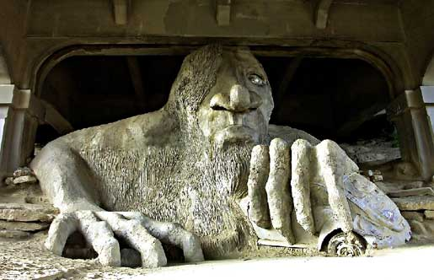
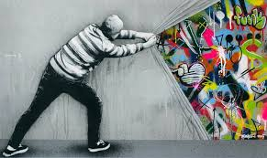

Slide 28
February 9, 2017
Street Art Analysis, Part II
Examine one (1) of the following pieces of street art. In your analysis, answer the following questions… Hint, hint… these are questions that you should also be answering in your Critical Review.
What’s going on in this artwork? Explain it. Describe the colors, form of art, etc.
What was your first reaction to this artwork? Why do you think you had the reaction?
Does your opinion about the artwork change the longer you look at it? Why?
What does this piece of art attempt to teach us? What is the statement it is making? Explain.

Slide 29
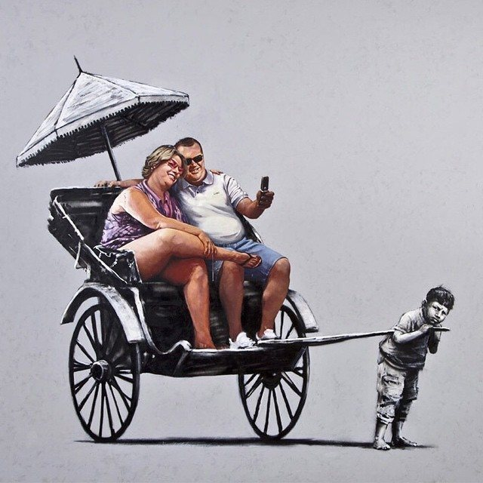

Slide 30
Criteria for the Critical Review on Art:
Heading
Name
Date
Block
Title
Should be multiple paragraphs
Double-spaced
Times-New Roman 12-point font
Paragraphs should be left-justified
No spaces between paragraphs
Include an image of the artistic piece
Name of art piece should be in italics
Submit to turnitin.com by the end of the day, Friday, 02/10/17
Use today wisely!!!
I need to check notebooks; I can check yours today or Friday… no later.

Slide 32
February 10, 2017
Favorite / Least Favorite Song(s)
What is one of your all-time favorite songs?
Specifically, what have you always enjoyed about the song? Be specific.
Describe the message of the song. What is it about?
Describe the lyrics – are they meaningful? Is there a theme? Important repeated words?
Describe the vocals – Nice harmonies? How would you describe the singer’s/band’s vocals?
What is one of your all-time least favorite songs?
Specifically, what have you always disliked about the song? Be specific.
Describe the message of the song. What is it about? Is this one of the things that you dislike about the song? Explain.
Describe the lyrics – are they meaningful in any way? Pointless? Is there a theme? Repeated words?
Describe the vocals – How would you describe the singer’s/band’s vocals? Are they decent, or should the singer return to the shower to sing? Explain.

Slide 33
February 15, 2017
Why the Hate?
Why is it so much easier to hate on something rather than praise it? Why do we find so much more satisfaction and joy out of bashing something (a song, movie, commercial, product, etc.) rather than celebrating it? Provide an explanation in a thoughtful response.

Slide 34
February 23, 2017
Getting Stuck in the Negatives
After watching Alison Ledgerwood’s speech, why is it that we almost have to work harder to see the upside in things?
Do you agree with what Ledgerwood has stated? Why or why not?
Will this cause you to look at things differently? School? Extra-curricular activities? Your friendships? Relationships with family?
How much of what Ledgerwood said is in line with what you stated in last week’s Warm-Up?

Slide 35
February 27, 2017
Is Music a Source of Change?
Does music inspire change, or does change inspire music? Explain.
What would the artist need to do within his/her song to bring about this change? Are the lyrics enough, or would other aspects need to be employed? Rhythm? Production? Vocals? Or do any of these things even matter?
How does music work differently in promoting change as opposed to visual art, such as paintings, street art, and even film? Explain.

Slide 36
“Wear Sunscreen” Response Please copy into the Writing Assignments section of your notebook.
After listening to and reviewing the lyrics to “Everybody’s Free To Wear Sunscreen,” look at some of the advice that was presented in the song.
What do you believe to the most important advice given?
Write down the top three (3) pieces of advice that you feel are the most important.
1.
2.
3.
On your own, answer the random questions that are provided to you. Be prepared to share and discuss.

Slide 37
1. What types of instruments are heard? Are they used alone or are they used for accompaniment?
2. What musical changes occur during the song? Where and why do they take place?
3. Describe the voice(s) that you hear. What is purpose of “singing” the song in that fashion?
4. Who were the song’s “consumers” and “listeners”?
5. What is the purpose of the song? Entertain, encourage, persuade, etc.
6. What is the main theme of this song?
7. What is the artist’s message? Is there more than one message?
8. List the advice that the “singer” provides? Why does he provide them?
9. Compare this song to a similar song. Note similarities and differences.
10. Does this song inspire change? Why or why not?
11. Now that you have heard this song, will you live your life differently? Why or why not?
12. Imagine you are the artist. What is one piece of advice that you want to give the audience? Why?

Slide 38
How is the “Class of ’99” different from the “Class of 2018”?
Using personal knowledge and experience with your own lives and lyrics from the song, complete a compare/contrast chart like the one that follows... Consider values, attitudes, relationships, ideals, etc.
Class of 1999 | Similarities | Class of 2018

Slide 39
Class of 1999 | Similarities | Class of 2018

Slide 40
March 3, 2017
Early Making a Murderer Review
Now that we have watched 30 minutes of the first episode of Making a Murderer, what do you think? Begin an early review…
What do you think that the filmmakers have done right? Specifically, in which areas does the documentary excel?
In your opinion, what do you think the filmmakers have done wrong? Specifically, in which areas do you think the documentary fails?
In your response(s), consider the documentary characteristics that we discussed last class:
The observations (seen by you; remember you’re the ‘fly’ on the wall)
The interviews
The dramatization, i.e. reenactments
The exposition of the story

Slide 41
March 7, 2017
Social Media and Youth Today
Do you use social media? If so, which forms of social media do you use? Why do you use these forms of social media? Please think outside of simply saying, “it’s fun” and be honest in your response.
Assuming you were going to make a documentary on the relationship between teenagers and social media…
Which forms of social media would you spotlight?
Who would you have interviewed? Any teenagers in particular? Celebrities? Youtube personalities? Choose 2-4 “authorities” on the subject who you feel would provide an interesting lens. Why do you feel that these individuals would be perfect for this job? Explain.

Slide 42
Making a Murderer Slate Review Questions Please copy into the Writing Assignments section of your notebook.
Read the article, “The Emotional Manipulations of Making a Murderer.”
The author of the article, Bronwen Dickey, has viewed the documentary series in its entirety and is attempting to answer the analysis questions.
Reread the article and identify where Dickey answers these questions.
In your notebook, write down Dickey’s response to these questions.
Feel free to integrate your own opinion(s) and answer the questions as well… especially if Dickey’s answer(s) are not easily identifiable!
There are 19 questions; you will be randomly assigned to answer one (1) set of questions:
1 – Author & Audience (1-7)
2 – Messages & Meanings (8-15)
3 – Representations & Reality (16-19)

Slide 43
March 13, 2017
Return to Shakespeare
Before we begin The Taming of the Shrew, it is important that we get reacquainted with William Shakespeare. Describe your experience(s) in year’s past with reading William Shakespeare:
What have you read? What do you remember?
What is fun about reading Shakespeare?
What is difficult about reading Shakespeare?
What advice would you give to students who are reading Shakespeare for the very first time?

Slide 44
March 15, 2017
Strong Women = Evil Women(?)
Do you think that strong women are synonymous with evil women? In other words, if a woman is strong (physically, emotionally, mentally), does this automatically make her mean? Why or why not? Explain.
Why do others (many times, men) get thrown off and intimidated by women who are strong and independent? Explain.
Conversely, why do you think that some women are hesitant to speak their minds and be independent? Explain.

Slide 45
March 21, 2017
Relationships and Change
Take a look at the following statements and state if whether or not you agree or disagree with each:
If you love someone, you will do what he/she asks you to do.
The best relationships are between two people who are equal to each other in intelligence and ambition.
If you love someone, you should never try to change him/her.
In every relationship, there is always one person who is “in charge.”
Being in love can make you change things about yourself.
What type of balance is necessary for a relationship/marriage to be successful? This is in terms of changes in yourself/the other person, compromise, etc.? Explain.

Slide 46
Today’s Players:
Narrator:
Translator:
Christopher Sly:
Lord:
First Huntsman:
Second Huntsman:
Servant / First Servant:
Second Servant:
Third Servant:
Player:
Page:
Hostess:

Slide 47
March 23, 2017
Casting the Induction
Cast the following roles that play a part in the Induction scenes. Which actor(s) do you envision playing the following characters? In each of your casting decisions, respond to why you feel that each actor is a perfect fit for the role.
Christopher Sly
The Lord
The Page (the boy assistant who pretends to be the woman)
Considering that the characters in the Induction scenes do not come back into the play, why do you think they are included? What do these scenes let the reader/audience know about the play? Explain.

Slide 48
TotS Character Motivation – Act I Please copy into the Writing Assignments section of your notebook
Intrinsic Motivation: When someone does something for no apparent outside rewards. They are doing it for their own well being, education, happiness, etc.
Extrinsic Motivation: When someone does something for an outside reward such as money, praise, or an award.

Slide 49
Character | Description of character | What is their “action plan”? | Motivation? Intrinsic or Extrinsic? How? Why?
Lucentio
Tranio
Hortensio
Gremio
Petruchio
Baptista

Slide 50
April 5, 2017
Masculinity Today
Masculinity can be defined as “the possession of the qualities traditionally associated with men.”
In your opinion, what does it mean to be masculine in society today? Explain using at least 3-4 characteristics.
Is masculinity today seen as a positive or negative? Explain.
What can men and women do to further strengthen the positive aspects of masculinity today?
What can men and women do to further diminish the negative aspects of masculinity today?

Slide 51
April 7, 2017
Verbal vs. Physical Anger
Which form of anger do you think is most effective in getting someone’s attention? Verbal or physical? Why do you think this is? Explain.
Is either form effective in making a statement and creating/causing change? If so, which one? Why is this? If not, why? Explain.

Slide 52
April 17, 2017
Power in Relationships
Below are four different kinds of relationships. How is power seen within each? With each of the following relationships, discuss how power is used, abused, or subverted (undermined or overthrown) in each of the following relationships:
1. Master-servant
2. Parent-child
3. Husband-wife
4. Nobility-lower class

Slide 53
Today’s Players:
Narrator:
Katherine:
Petruchio:
Lucentio:
Baptista:
Tranio:
Biondello:
Gremio:
Bianca:

Slide 54
April 19, 2017
Sexism in Society Today
Sexism can be defined as the prejudice, stereotyping, or discrimination on the basis of one’s gender.
What are some particular sexist attitudes and stereotypes that are continually perpetuated in society today? Describe at least two (2) sexist “beliefs” towards each sex, i.e. 2 towards women and 2 towards men (4 total).
Why do you think that these beliefs are still presented in society? Do you think that these attitudes will ever change? Why or why not? Explain.

Slide 55
Men | Women
Men are pigs Men who sleep around are cool Men can’t like each other Men are criminals A man should never hit a woman | Women are poor drivers Girls can like each other and it’s hot Women who sleep around are sluts Women are superficial, materialistic, gold diggers. Women belong in the kitchen Women have a lot of baggage Women are more mature than men Girls wear skirts Women are indecisive Angry girls means it’s their time of the month.

Slide 56
Men | Women
Men are pigs. Poor HI gene, Gross, Fart jokes Brutes Athletic Strong Not allowed to cry NO EMOTION Provider Only want sex CEO More likely to get job (Hard work) Protector Not loyal CHEATERS Initiator | Always cry Dependent on man Belong in kitchen Sassy, Nasty Smart, Successful GOLD DIGGERS Crazy in arguments Emotional 12 times a year Only purpose to give birth Pretty, Beautiful, Gorgeous Judgmental Hold grudges Take forever to use the restroom Indecisive CRAAAAAZY

Slide 57
Today’s Players:
Narrator:
Petruchio:
Katherine:
Grumio:
Tranio:
Hortensio:
Biondello:
Baptista:
Merchant:
Haberdasher:
Tailor:
Vincentio:

Slide 58
April 21, 2017
The Art of Arguing
Describe an argument that you recently got into.
What was the argument about?
How did it start?
Who “won” the argument? Or did it ever end?
Did any side “give in”?
Describe the link between arguing and pride. How are they interrelated? Explain.
Describe how arguing is similar / different among the following relationships:
Parent-child
Husband-wife
Teacher-student
Siblings

Slide 59
Today’s Players:
Narrator: Dino
Petruchio: Avery
Katherine: Svea
Vincentio: Caleb
Hortensio: Chris
Lucentio: Eric
Baptista: Wes
Tranio: Megan
Bianca: Samantha
Biondello: Carter
Gremio: Derrick
Widow: Emilyn

Slide 60
Feministic? | Analysis | Misogynistic? | Analysis

Slide 61
May 1, 2017
Most Embarrassing Memory / Moment
In detail, describe your most embarrassing memory. In your description(s) of the event, be sure to address the following points:
How old were you?
Where were you?
What is the backstory? In other words, what led you to this event/moment in time?
How do you look back upon this moment now? With anger? Resentment? Laughter? More embarrassment? Indifference?

Slide 62
May 3, 2017
Memoir Journal Grab Bag!!!
Choose and respond to one (1) of the following journal prompts. Please be specific in your response and describe the event in detail.
A. What is your best memory as a teenager with your friends? Describe.
B. What was your very first job? How much was your very first paycheck? What did you do with it? Explain.
C. Which one of your parents are you the most like? Why do you think this is? About when did you come upon this realization? What qualities and characteristics do you and your parent(s) share? Explain.
D. Who has had the greatest influence (either positive or negative) on your life thus far? Explain.

Slide 63
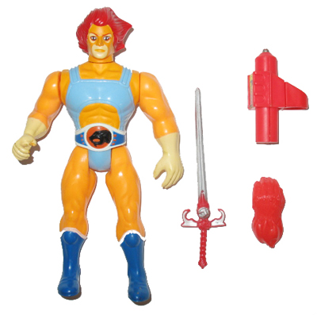

Slide 65
May 5, 2017
Universal Ideas Around Childhood
While everyone’s childhood is different, what would you say are the common characteristics and traits of childhood?
In other words, what are the common themes that are unique to everyone’s childhood? Describe 2-3 themes and provide 1-2 examples from your childhood that help illustrate these themes.

Slide 66
Artifact Exhibit Walk Please copy into the Writing Assignments section of your notebook.
Set your artifact out one of the front row desks.
Please do not publicly announce which one is yours. It will be the class’s responsibility to guess.
Examine at least five (5) artifacts that are around the room.
In your notebooks, respond to the following questions:
1. Describe the artifact that you see.
2. What do you assume to be the memories associated with the object? Describe.
3. What singular idea of childhood does this artifact represent? Explain.

Slide 67
May 9, 2017
First Day of School Memories
Recall a first day of school when you were younger (grades pre-school – 6th).
How did you view school: with excitement, dread, or boredom? How did you react to teachers?
How did you interact with classmates? What was the hardest thing for you to cope with? Please explain in detail using complete sentences.

Slide 68
May 11, 2017
Vivid Verbs and Adjectives Practice
Taking a look at both the Reference List handout and the “Breathtaking Adjectives” handout, correct the following sentences by making the adjectives and verbs more VIVID:
The woman’s perfume smelled bad.
Joey quickly walked to the gas station in between classes.
Ramon stared at the young woman’s beautiful eyes.

