Slide 1
Memoirs: Definitions, Examples, and Idea-Starters
Please copy into the Writing Assignments section of your notebook.

Slide 2
What is a memoir?
A subcategory of an autobiography (part of a life story)
A personal narrative
A record of events based on the author’s recollection
A memory (From French mémoire)
A retrospective account of a memorable event
A composition about a personal experience that focuses on the relationship of the memory to the author.
A “snapshot” of a moment in time.

Slide 3
Memoirs allows us…
To look at simple events truthfully and honestly, finding the “interesting” element through the process.

Slide 4
Books For Example…
David Sedaris Me Talk Pretty One Day
Lance Armstrong It’s Not About the Bike
Joan Didion The Year of Magical Thinking
Anne Frank The Diary of a Young Girl
Frank McCourt Angela’s Ashes
Maya Angelou I Know Why the Caged Bird Sings
Barack Obama Dreams from My Father: A Story of Race and Inheritance
Stephen King On Writing: A Memoir of the Craft
Ernest Hemingway A Moveable Feast

Slide 5
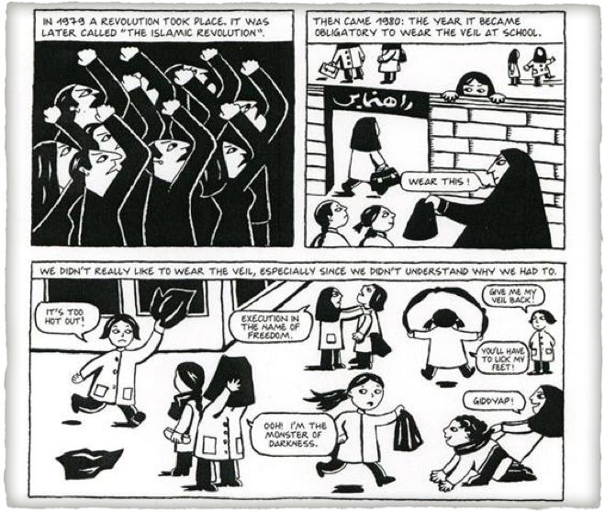
Graphic Memoir
Persepolis
by
Marjane Satrapi
(2000)

Slide 6
Memoirs in Art

Slide 7
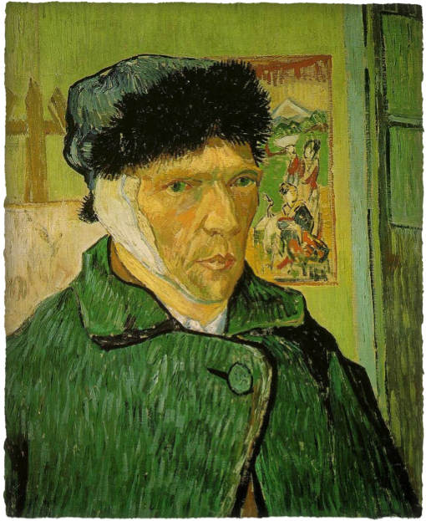
Vincent Van Gogh Self Portrait 1889
Courtauld Institute Galleries
London, England

Slide 8
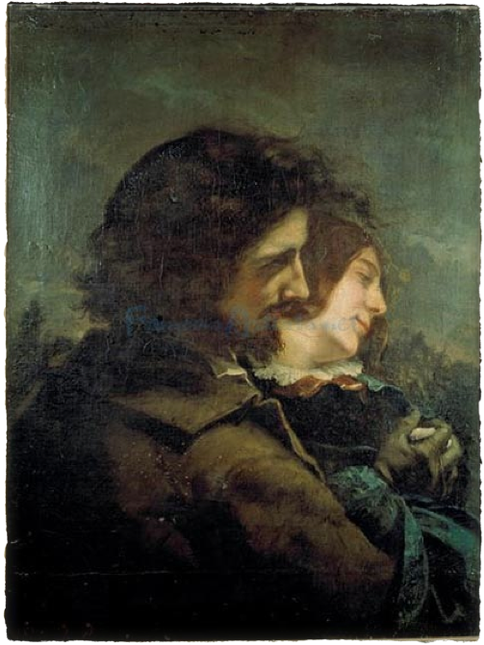
The Lovers in the Countryside
(1844)
Gustave Courbet
Musée des Beaux-Arts
Lyon, France

Slide 9
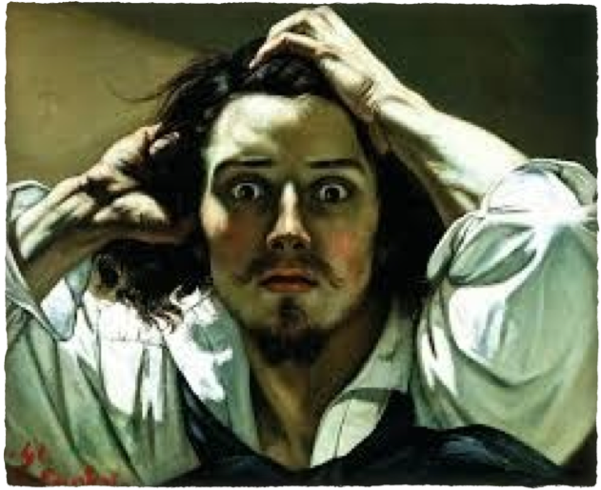
The Desperate Man
(1843-45)
Gustave Courbet
Private Collection

Slide 10
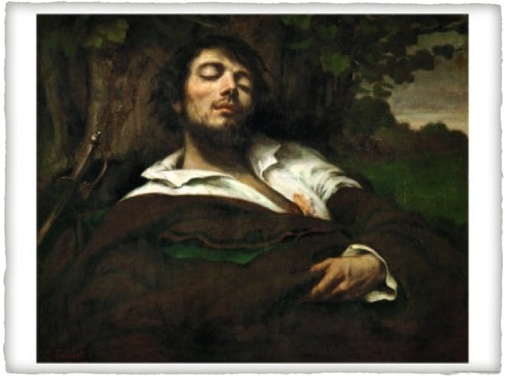
The Wounded Man
(1844-1854)
Gustave Courbet
Musée d’Orsay
Paris, France

Slide 11
Memoirs in Music
“Get Her Back” – Robin Thicke
Reflections on his lost love
http://www.youtube.com/watch?v=bz_EqawkmTg
“Live Like You Were Dying” – Tim McGraw
Reflections about his father death
http://www.youtube.com/watch?v=_9TShlMkQnc&feature=kp
“Piano Man”– Billy Joel
Reflection on his career
http://www.youtube.com/watch?v=gxEPV4kolz0&feature=kp

Slide 12
Brainstorming…
Take a mental snapshot of a specific moment in time.
It can be any moment… Please do not think too much about it.
Write one sentence that answers these questions:
Where are you?
How old are you?

Slide 13
Imagine you are in the moment…
What do you see, hear, smell, feel, and taste?
Can’t remember? Then say so! Don’t make it up!!!
Write at least five (5) sentences.
Do not tell your story just yet; just put down the physical details that you remember.

Slide 14
The Backstory…
What is the backstory?
Specifically, how did you get to this moment?
What were you doing immediately before? Explain.

Slide 15
Reflection #1…
Describe yourself in this moment:
What was most significant about this moment to you in this moment?
How did you feel about the action, the person, and yourself?
What adjectives would you use?
What did you like to do, eat, read?

Slide 16
Identify the main events of this memory in at least 5 steps…
Now is the time to tell the memory.
Briefly restate and sequence the memory in at least five (5) main points.
Be sure that there is a beginning, middle, and end.

Slide 17
Reflection #2…
Who are you today compared to who you were then?
How do you think you have been affected today as a result of this moment in time?

Slide 18
Reflection #3…
What did the experience do for you in terms of how you think about yourself?
I understand that this can be difficult…
It doesn’t have to be deep and life-changing, just real.
It can even be a simple statement such as: “I loved cooking with my mother then and I still do.”

Slide 19
Reflection #4…
What have you forgotten about this moment that you wish you could remember?
Starting with “I remember…” write one sentence that tells the most memorable detail about this event.

Slide 20
Congratulations! You have the outline for a memoir!!!

