Slide 1
Myths & Urban Legends
Please copy into the Class Notes section of your notebook…

Slide 2
Let’s first distinguish between a Myth, Urban Legend, and a Fact…
Fact – something that actually exists; reality; truth: Your fears have no basis in fact.
Myth – a traditional or legendary story, usually concerning some being or hero or event, with or without a determinable basis of fact or a natural explanation.
Urban Legend – a modern story of obscure origin and with little or no supporting evidence that spreads spontaneously in varying forms and often has elements of humor, moralizing, or horror.

Slide 3
What is an Urban Legend? cont’d…
An Urban Legend is similar to modern folklore consisting of stories often thought to be factual by those circulating them.
Urban legends are not necessarily untrue, but they are often distorted, exaggerated, or sensationalized.
Urban legends are sometimes repeated in news stories and, in recent years, distributed by e-mail.

Slide 4
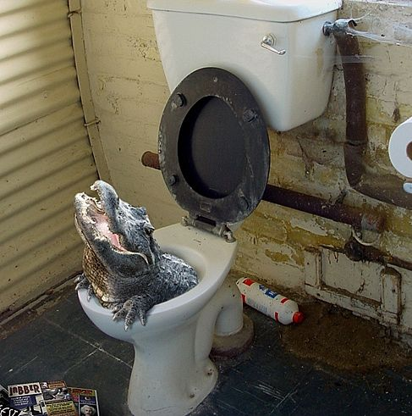
People frequently allege that such tales happened to a “friend of a friend.”
Some urban legends have survived a long time, evolving slightly over the years.
For example, The woman killed by spiders that were nesting in her elaborate hairdo.

Slide 5
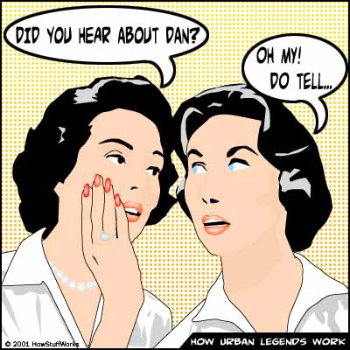
Newer legends tend to reflect modern circumstances.
For example, The people who were ambushed, drugged, and woke up minus one kidney.

Slide 6
Urban Legend Structure…
Urban legends are framed as complete stories with plot and characters.
The appeal of urban legends are its elements of mystery, horror, fear or humor, especially dark humor.
Many are “cautionary tales” or warnings, while others are “widely dispersed misinformation.”
For example, A college student will automatically pass all courses in a semester if one’s roommate commits suicide.

Slide 7
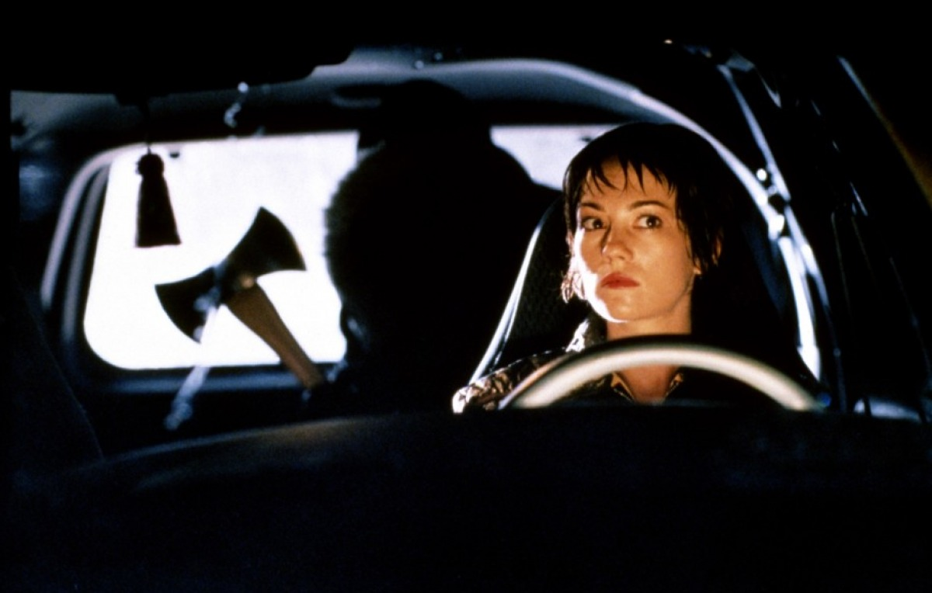
Many urban legends depict horrific crimes, contaminated foods or other situations which, if true, might affect a lot of people. Anyone believing such stories might feel compelled to warn loved ones.

Slide 8
Have you ever received one of these?

Slide 9
Watch the following TED Talk video…
As we view the video, identify what you feel are Michael Shermer’s main points:
http://www.ted.com/talks/lang/eng/michael_shermer_on_believing_strange_things.html

Slide 10
What does the town of Maycomb, and in particular, the children, believe about Boo Radley?
The MYTH of Boo Radley (from the childrens’ perspectives) – Chapters 1 & 2 | The TRUTH / FACTS about Boo Radley (from Miss Maudie’s perspective) – Chapters 5

